Slide 1
Fault Mechanics of the Luna Park Fault hosted in Sandstone in the Sydney Basin
Emily Benjamin

Slide 2
Outline of Presentation
Introduction to the problem
Background Information
Regional Geology
Study Area
Previous Work
Purpose and Importance
Research Questions
Methodology
Results
Concluding Thoughts

Slide 3
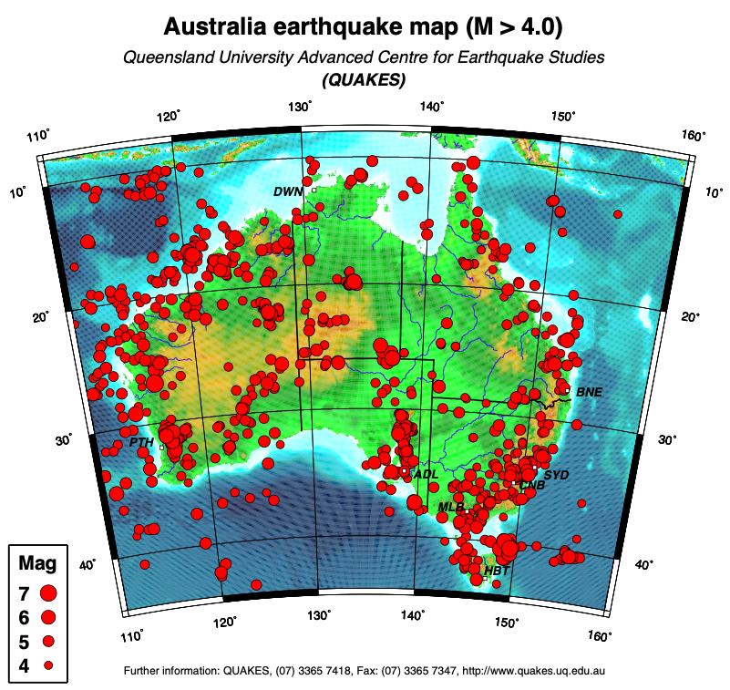
The Problem
Sydney Basin is a seismically active area
5.5 magnitude earthquakes and higher experienced
Newcastle 1989, 5.6 magnitude earthquake
Rock folds or fractures as a result of earthquakes
Lucas Heights Nuclear Power Plant discovered to be on top of ancient fault zones
Notes:
Source: http://www.quakes.uq.edu.au/quakeinfo.html#3

Slide 4
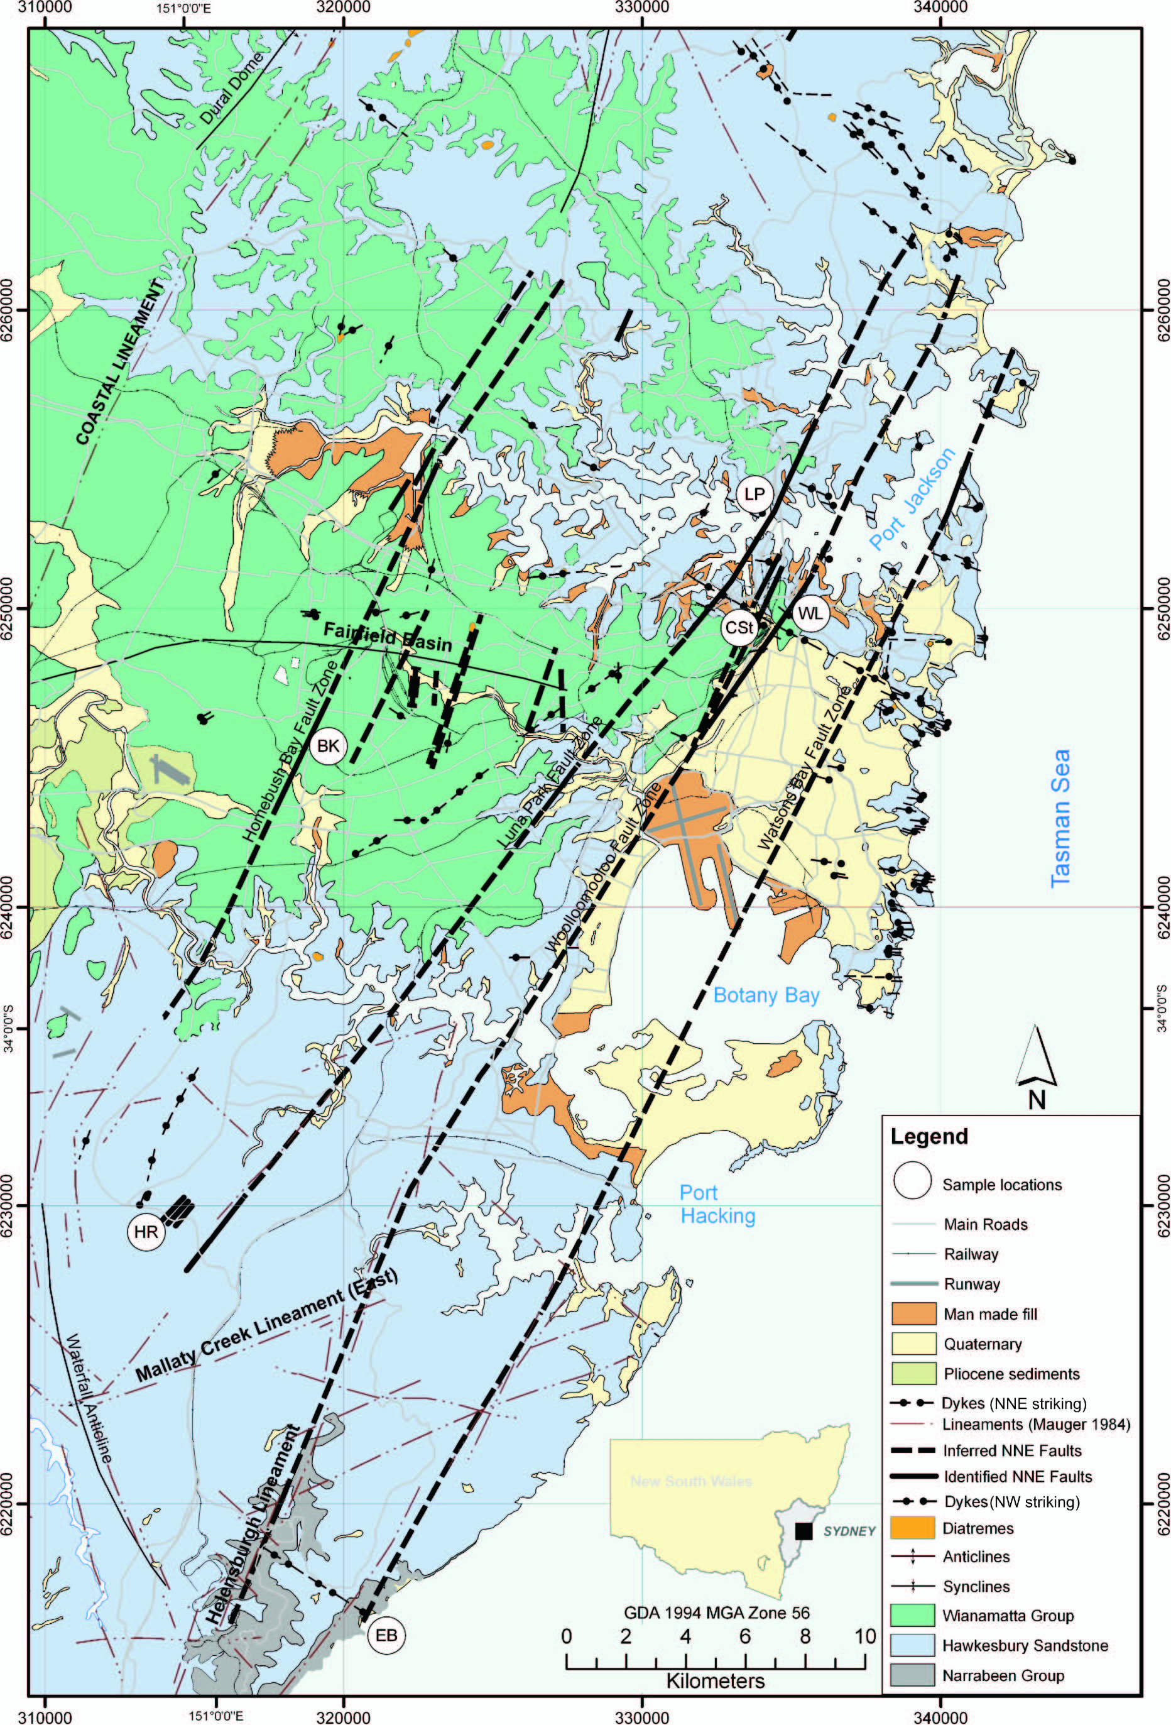
The Problem
Limited knowledge of sandstone-hosted fault zones
Focus on Luna Park Fault Zone
Must characterize fault zone in order to understand frictional strength properties and seismic risk associated
Trace of luna park fault zone picture for slide two
Och, D. J., Offler, R., Zwingmann, H., Braybrooke, J. and Graham, I. T. (2009) 'Timing of brittle faulting and thermal events, Sydney region: association with the early stages of extension of East Gondwana', Australian Journal of Earth Sciences, 56:7, 873 — 887.
Notes:
Source of map: Och, D. J., Offler, R., Zwingmann, H., Braybrooke, J. and Graham, I. T. (2009) 'Timing of brittle faulting
and thermal events, Sydney region: association with the early stages of extension of East
Gondwana', Australian Journal of Earth Sciences, 56:7, 873 — 887.

Slide 5
BACKGROUND INFORMATION

Slide 6
Regional Geology
Map to talk over

Slide 7
Regional Geology
Talk here about age, stratigraphy, fault occurred

Slide 8
Study Area
Stratigraphic age Mid Triassic 240 – 230 Ma
Deposited
Lucas Heights reactor development, excavation work meant the uncovering of ancient fault zones (here ancient = age range of 150 to 100 Ma ago)*
Fault zones mean that there is a degree of instability – the rock mass has been impacted by stresses and it has fractured and moved rock
Means that the rock has moved at one point in time, and pre-existing fault zones can move again with reactivation

Slide 9
Purpose

Slide 10
Importance

Slide 11
Research Questions

Slide 12
Methodology

Slide 13
Results

Slide 14
Concluding Thoughts

